Slide 1
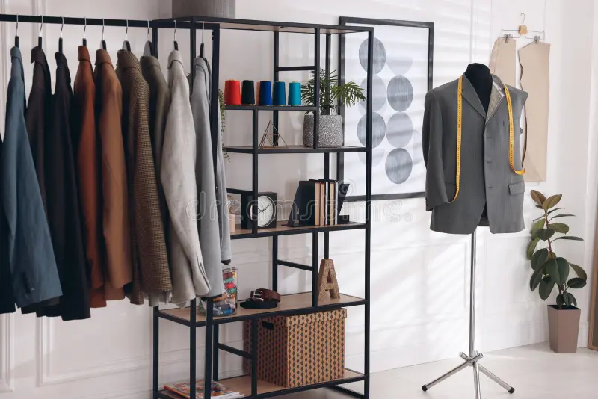
SEWCIAL
THE ULTIMATE TAILORING
SHOP
Submitted by,
Vishnu Satheesan
22PMC159

Slide 2
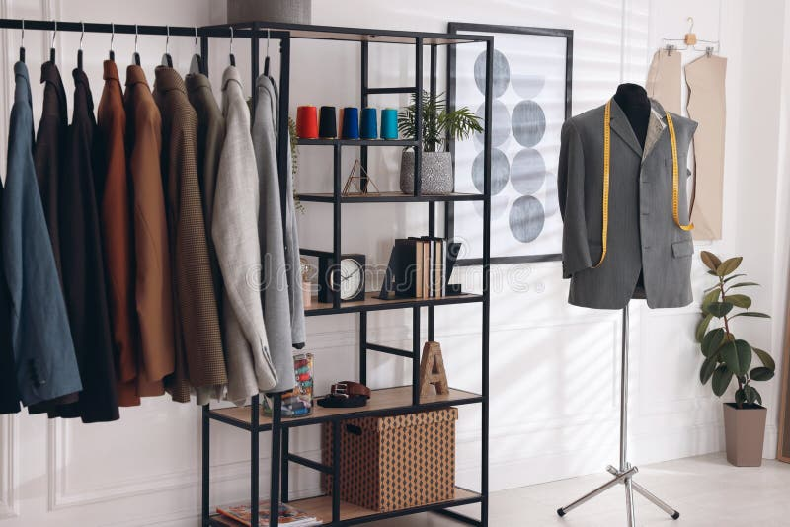
ABSTRACT
The aim of this project is to develop an online tailoring shop that provides a convenient and efficient platform for customers to order custom-made clothing items. The online tailoring shop will leverage the power of the internet and technology to streamline the traditional tailoring process, making it easier for customers to design and purchase personalized garments. The online tailoring shop will offer a user-friendly interface where customers can browse through a wide range of clothing options, including shirts, trousers, dresses, suits, and more. Overall, the online tailoring shop aims to revolutionize the way customers shop for custom-made clothing by providing a seamless online experience, personalized customization options, and exceptional craftsmanship. It strives to offer convenience, quality, and customer satisfaction, making it the go-to destination for those seeking tailor-made garments

Slide 3
REQUIRMENTS
Account Registration : The registration function shall allow users to create secure accounts. The account will track the user’s name, address, phone, email and password.
Account Login : Once verified, users will be able to access account history, purchase clothes online, and update their account information.
User Feedback: User can give suggestions to the site owner about items.
Update Account Information : The update account information function shall give account members access to edit their stored information.
Account Logout: The account logout function shall allow account members to exit their account for security purpose
Admin Login: Admin can login separatedly for add and delete items.
Product Update and Delete: Admin can update and also delete the product.
Password Reset: User Can reset their own password.
Services: Services indicates that user can select which type of cloths to be made.
Filter: User can select clothes seperatedly using filters
Purchase: User can purchase the item.

Slide 4
FEATURES & HIGHLIGHTS
User Login
User Registration
Admin Login
Purchase Items
Customer Feedback
User Profile Update
Product Add
Product Update and Delete
Forgot Password
Select Products Using Filter

Slide 5
ARCHITECTURE
Presentation Layer:
User Interface (UI): This layer includes the components that interact with users, such as web pages or mobile app screens.
Django Templates: Django's built-in template engine allows you to define HTML templates that render dynamic content and interact with the back-end.
Application Layer:
Django: Django serves as the back-end framework, handling HTTP requests, routing, and managing the application's business logic.
Django Views: Views receive requests from the user interface, process data, and generate appropriate responses. They interact with models, services, and external APIs as needed.

Slide 6
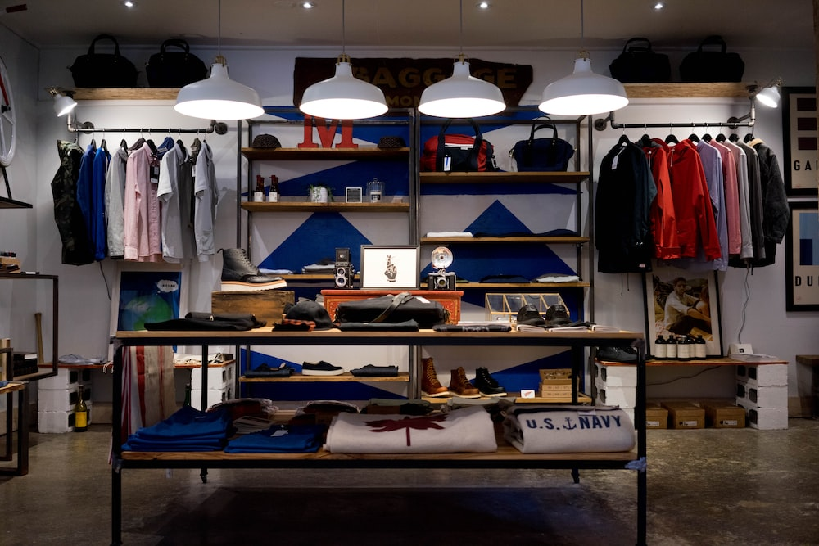
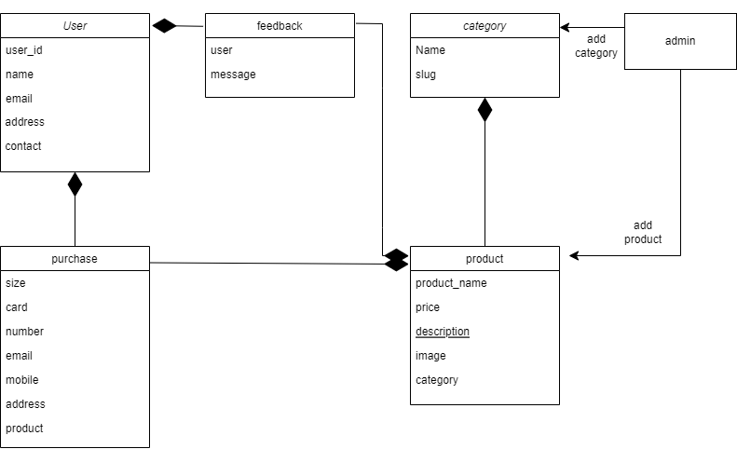
CLASS DIAGRAM

Slide 7
CHALLENGES
User Experience and Interface Design: Designing an intuitive and user-friendly interface for users and administrators is crucial. Ensuring a smooth user experience, from selecting products using filters, can be challenging, particularly when dealing with complex workflows and large data sets.
Real-time Availability and Pricing: Fetching real-time availability and pricing information for travel services from external providers can be challenging. Dealing with rate limits, handling concurrency, and caching strategies are considerations for ensuring timely and accurate information.

Slide 8
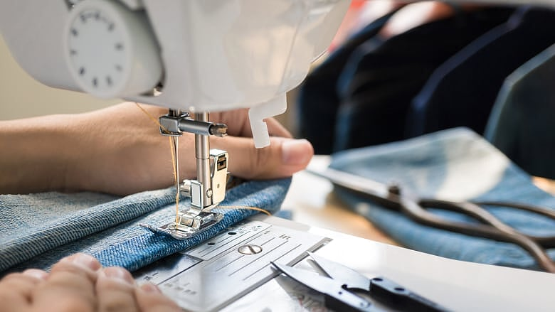
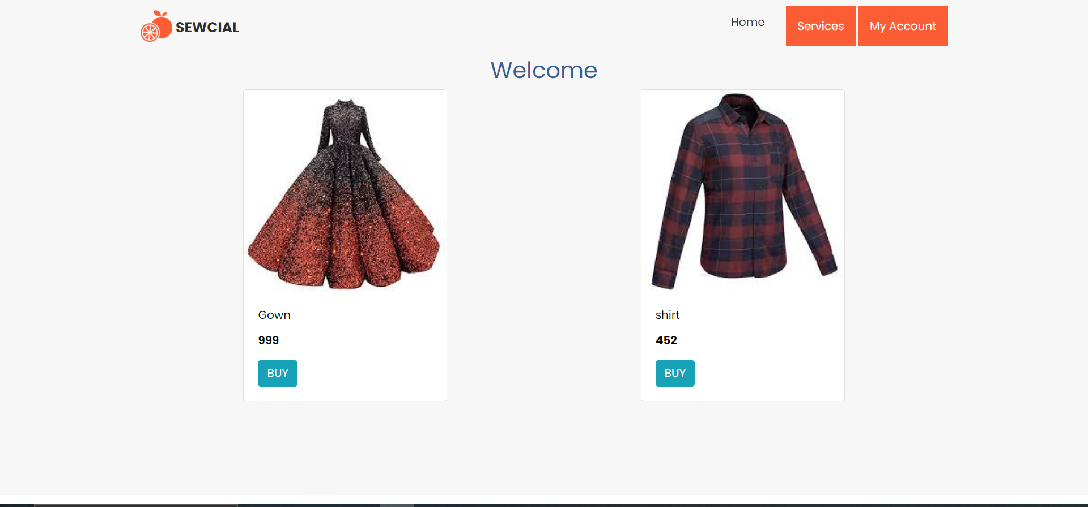
PRODUCT VIEW
The user become login then it redirect to the users home page. In that page user can see all the product type that are added by the admin.

Slide 9
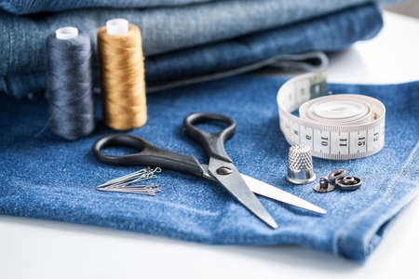
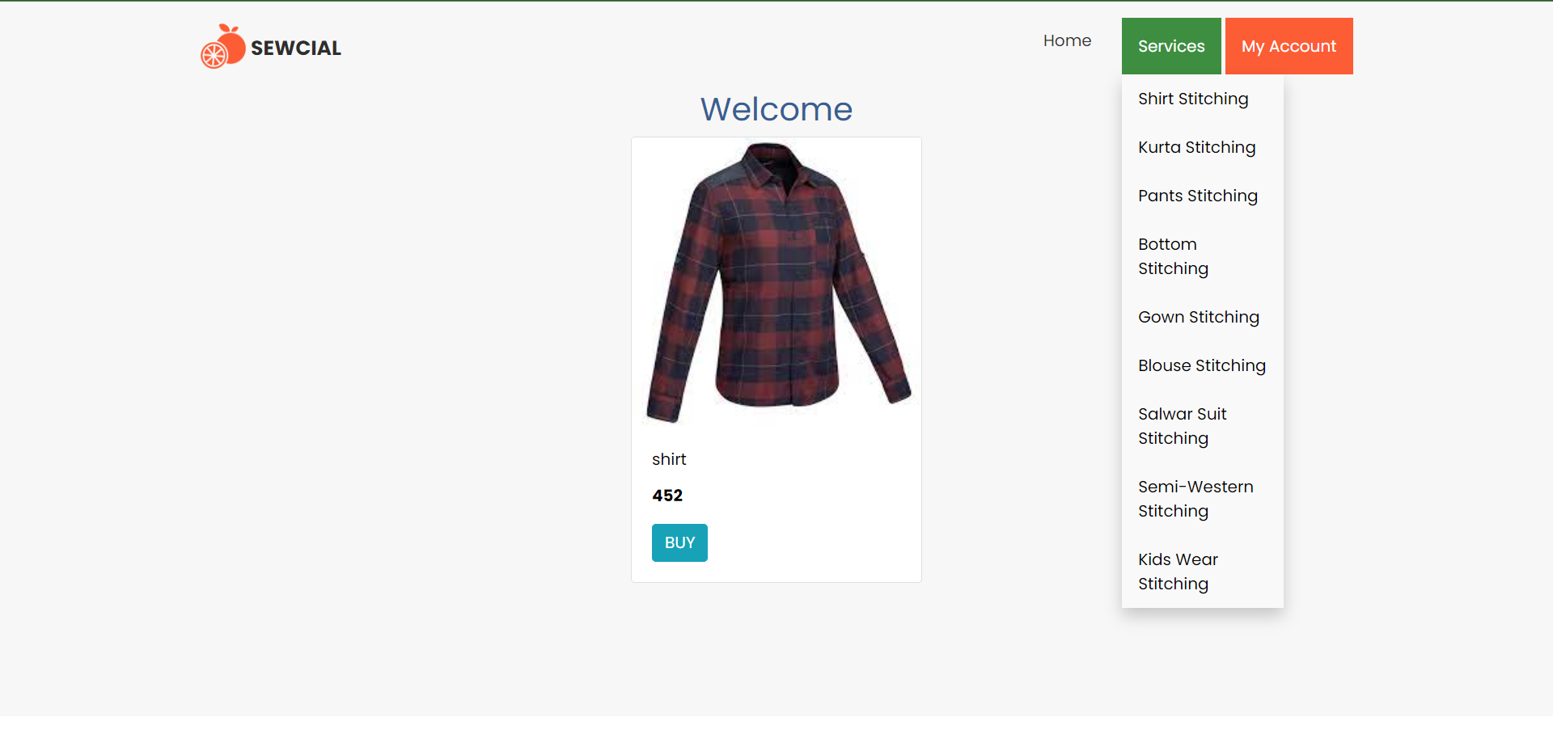
FILTER
User get clothing category wise

Slide 10
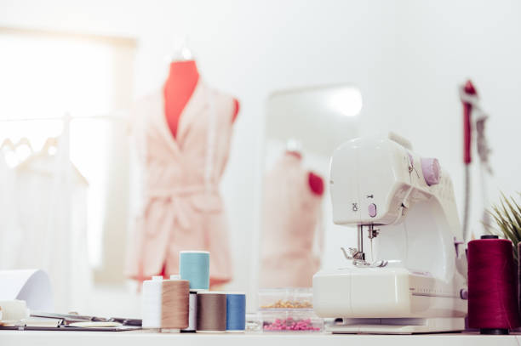
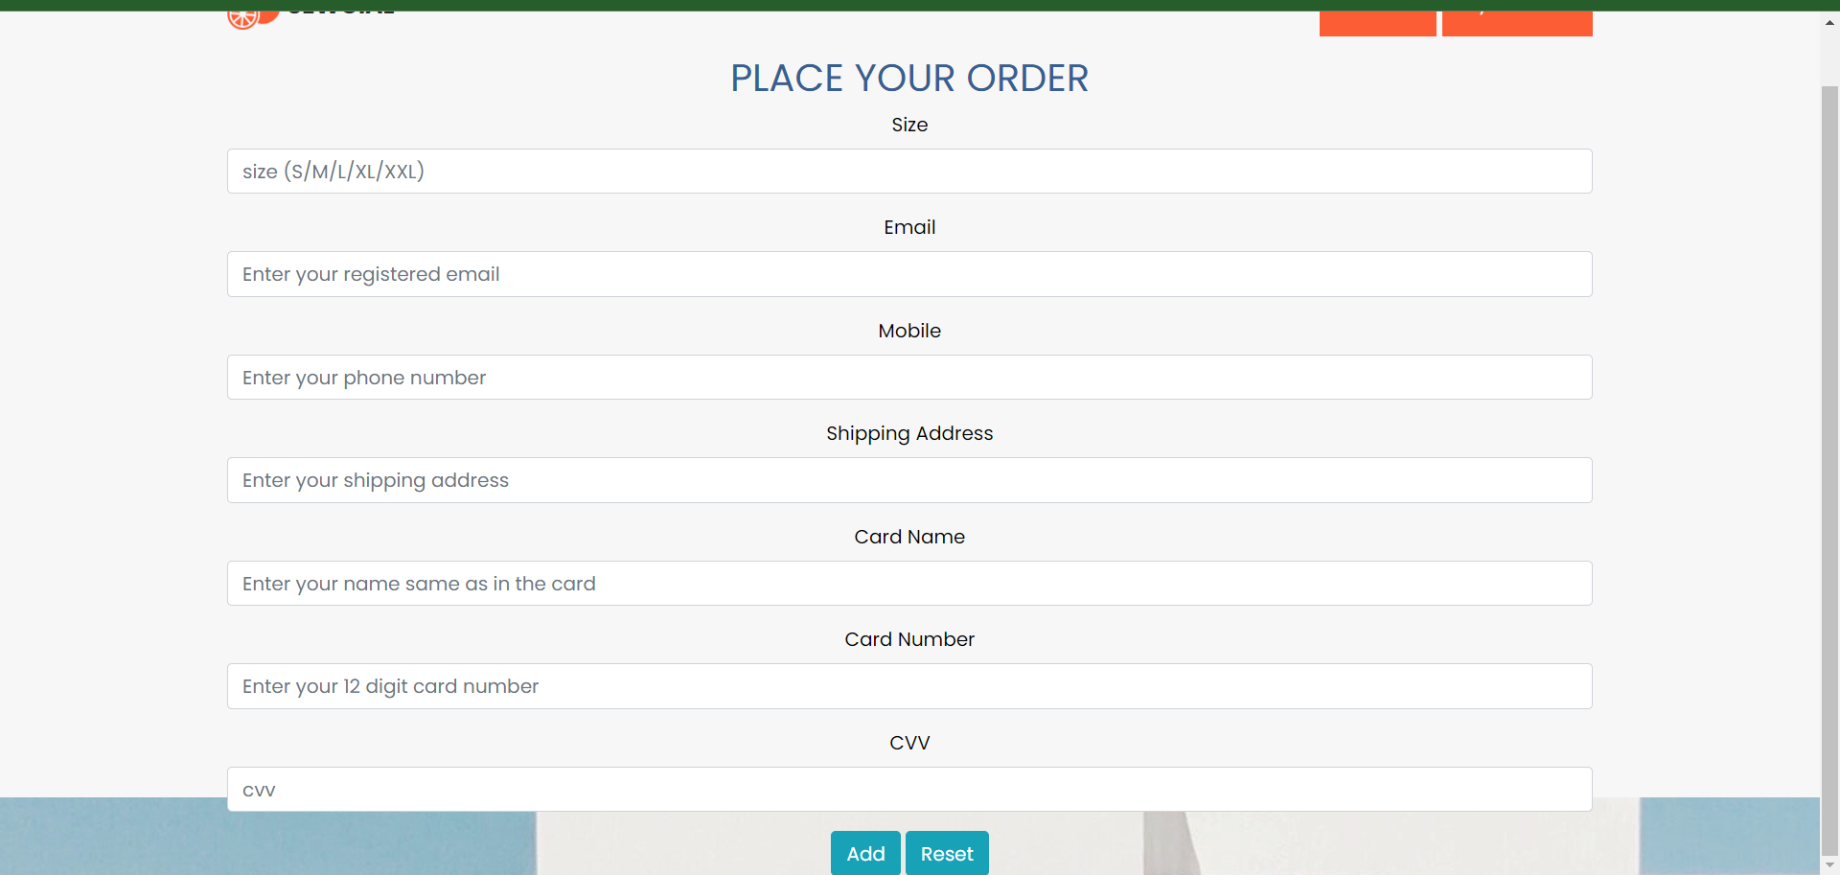
OREDR PLACING
User can order his custom made clothing using the interface shown in the picture.

Slide 11
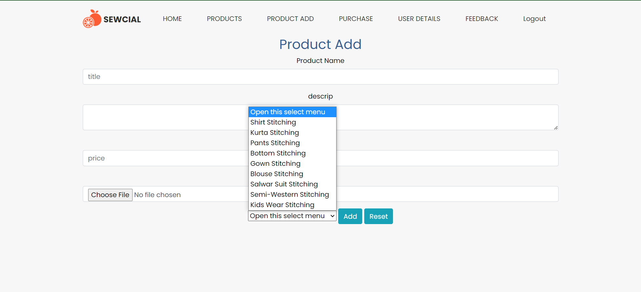
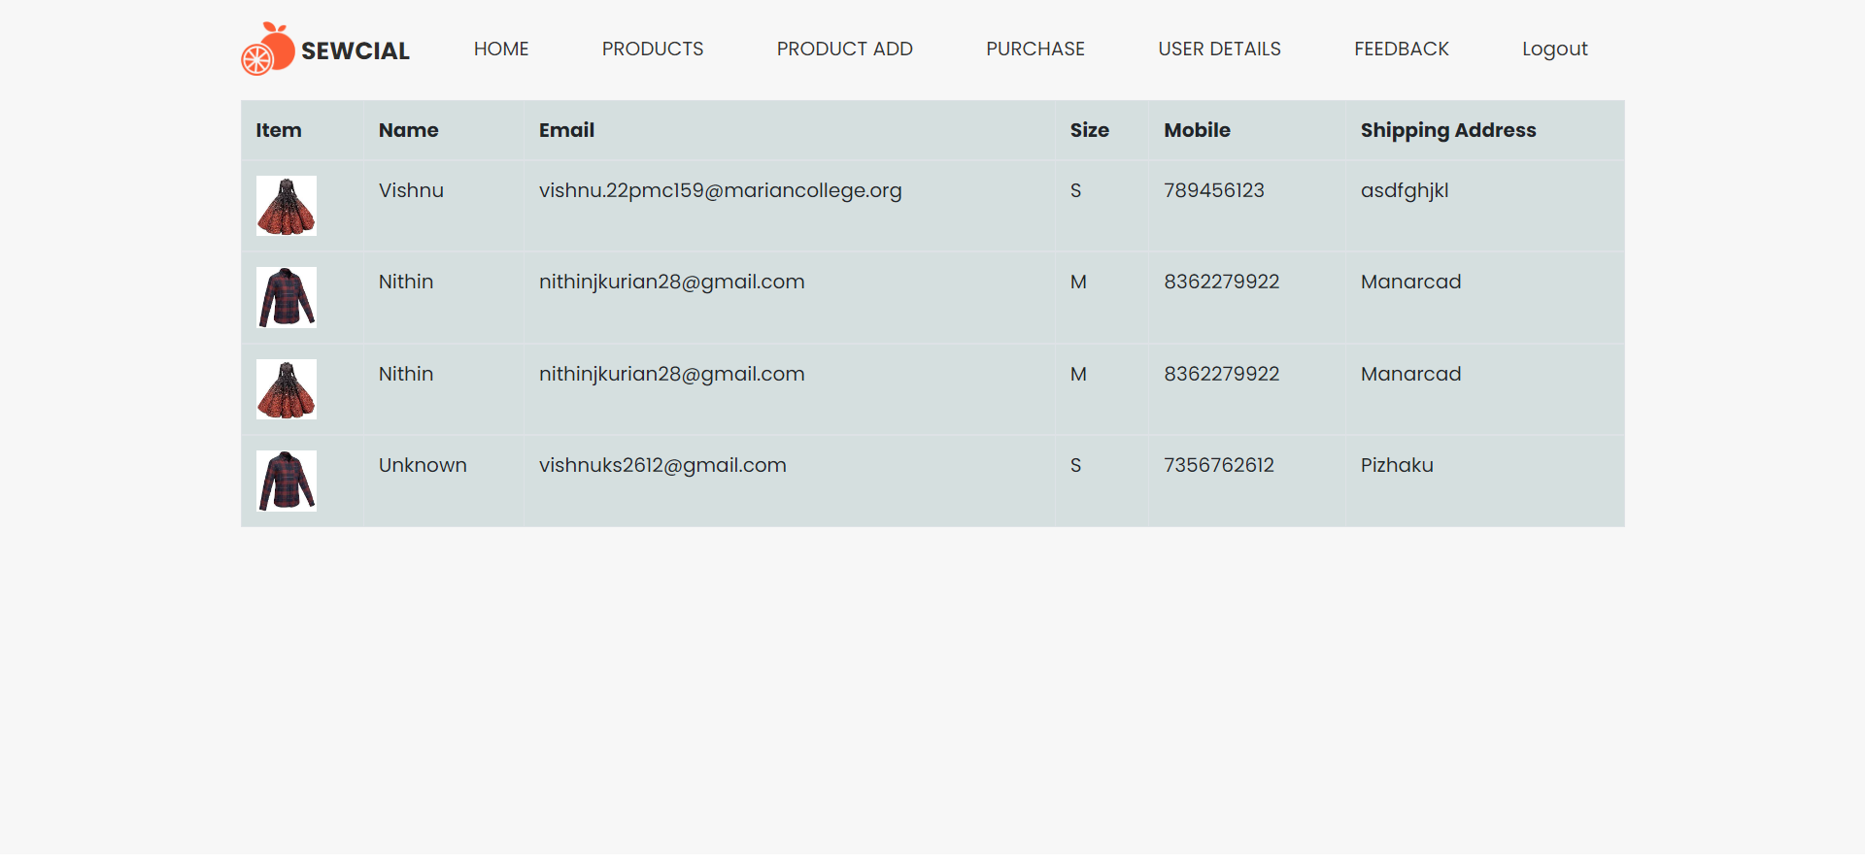
ADMIN INTERFACE
Admin can manage clothing related functionalities, like add, update delete clothing category wise. And admin can view feedback from customers, purchase related things and customer details.

Slide 12
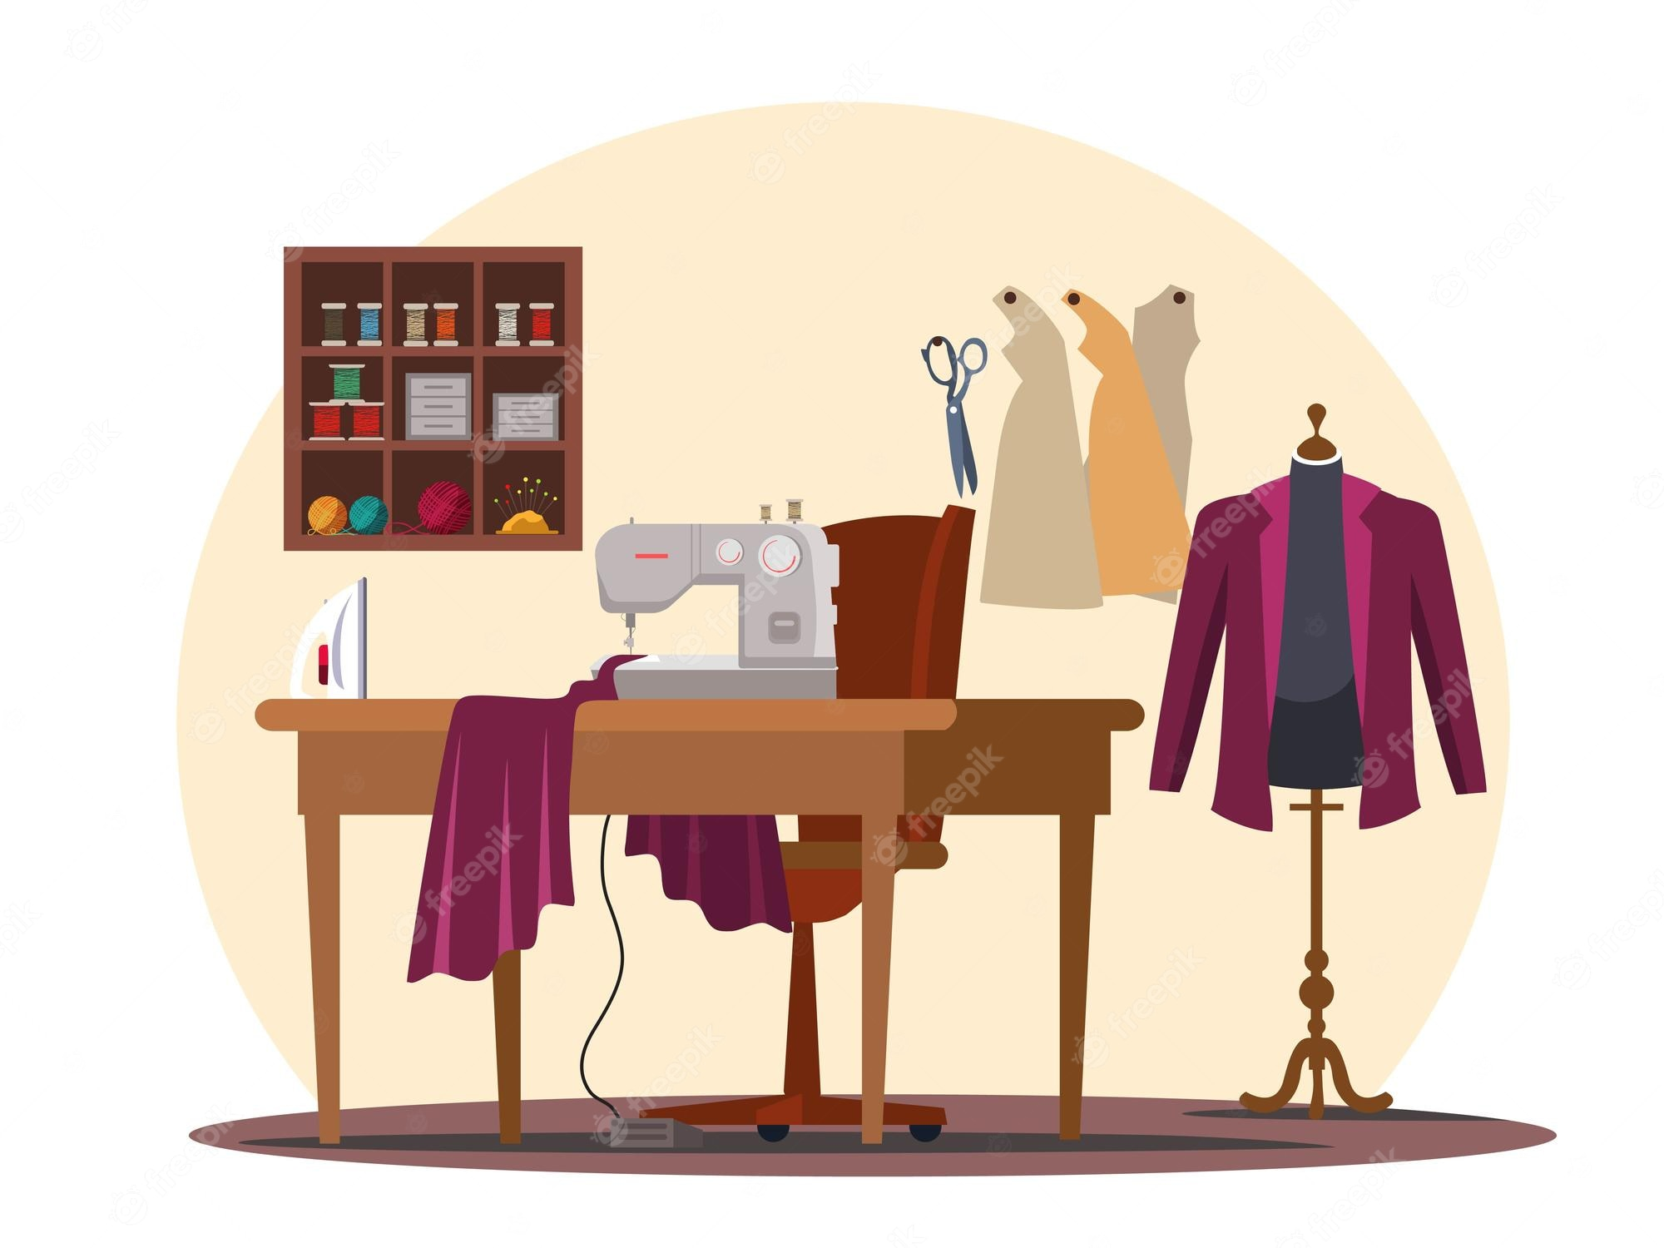
FUTURE ENHANCEMENT
The user can add suggestions about new designs with images
Payment method
Adding new users for tailoring
Also customers can design who is going to stitch his/her item/clothes

Slide 13
CONCLUSION
In conclusion, our clothing project SEWCIAL is an innovative and exciting venture that aims to revolutionize the fashion industry. Through extensive research, creativity, and collaboration, we have developed a collection that embodies style, sustainability, and functionality. Overall, our clothing project SEWCIAL represents a holistic approach to fashion, combining sustainability, style, functionality, and inclusivity. We believe that our collection has the potential to inspire positive change within the industry and encourage consumers to make more conscious fashion choices.
Thank you for your attention and support. We look forward to sharing our clothing project SEWCIAL with the world and making a lasting impact on the fashion landscape.

Slide 14
REFERENCES
https://www.epitomestitches.com

Slide 15
THANK YOU

